Slide 1
Custom Source of Truth Image, “CI-ified”
This is basically a lil’ tour. [More Network Automation Tapas]
Wed, December 11th, 2024

Slide 2
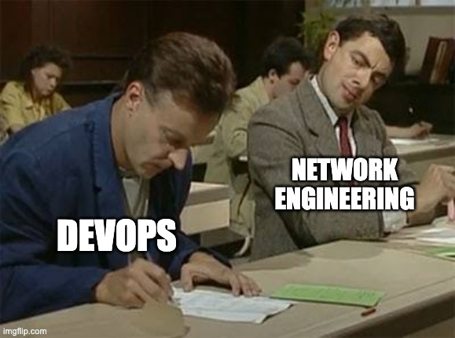
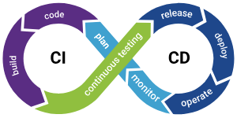
What the heck is that title?
CI is Continuous Integration. This is different than “CD”.
This is “the thing” you set up so many tasks can be run automatically whenever you commit code to your repository.
I totally used this image at CommEx this year

Slide 3
Oooo. What kinds of tasks?
Ruff > Black/Flake8 and you should use it
Formatting | ruff --version && ruff format --diff
Linting | ruff --version && ruff check --output-format=gitlab
Running unit tests | coverage run --omit="test*" -m pytest -rA coverage report --fail-under=80
Building and publishing your code as a Python package | poetry version "$MYVER" poetry build poetry publish -r my-cool-repository
Building and publishing your custom container | docker build -t “$IMAGE_NAME:$TAG” -f Containerfile . docker push “$IMAGE_NAME:$TAG”
Telling Santa about your amazing commit message habits | echo "Dear Santa, I've been good this year!" | mail -s "Christmas Wishlist" santa@northpole.edu

Slide 4
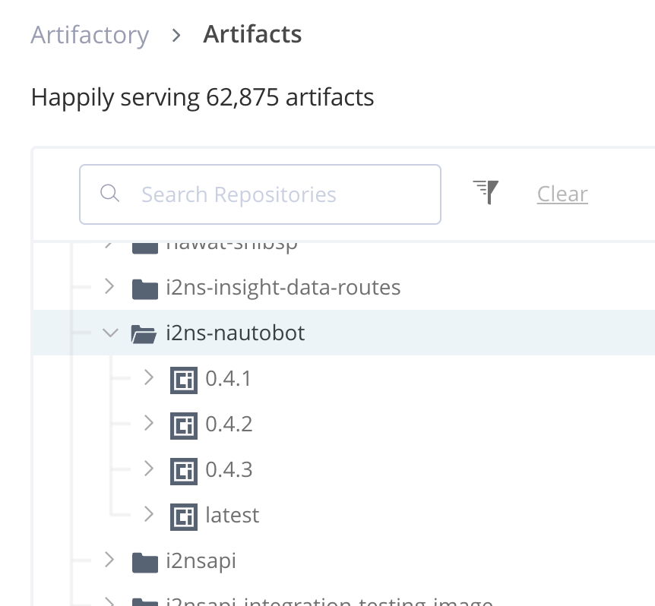
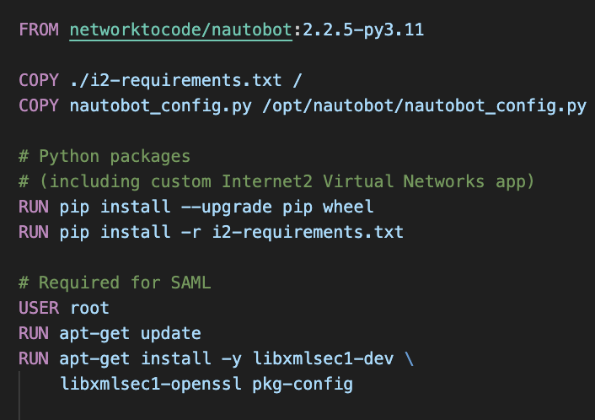
And the other part of the title?
Many custom images are can be simplified as:
A base container image.
A script ran to add things on top of that base container image, such as files or additional packages.
Those Two Things = Custom Container Image
networktocode/nautobot:2.2.5
We use Nautobot at Internet2
Containerfile (Simplified for presentation)
This is like our own private Dockerhub

Slide 5
My CI To-Do List
Build and publish my plugin (A humble Python package.)
Make note of which version I gave my Python package just now and store it in a requirements.txt file.
Build and publish my Really Cool Custom Nautobot image using the requirements.txt file.
???
Profit! (Deploy!)
Cloud or AI or some kind of Christmas magic happens here.

Slide 6
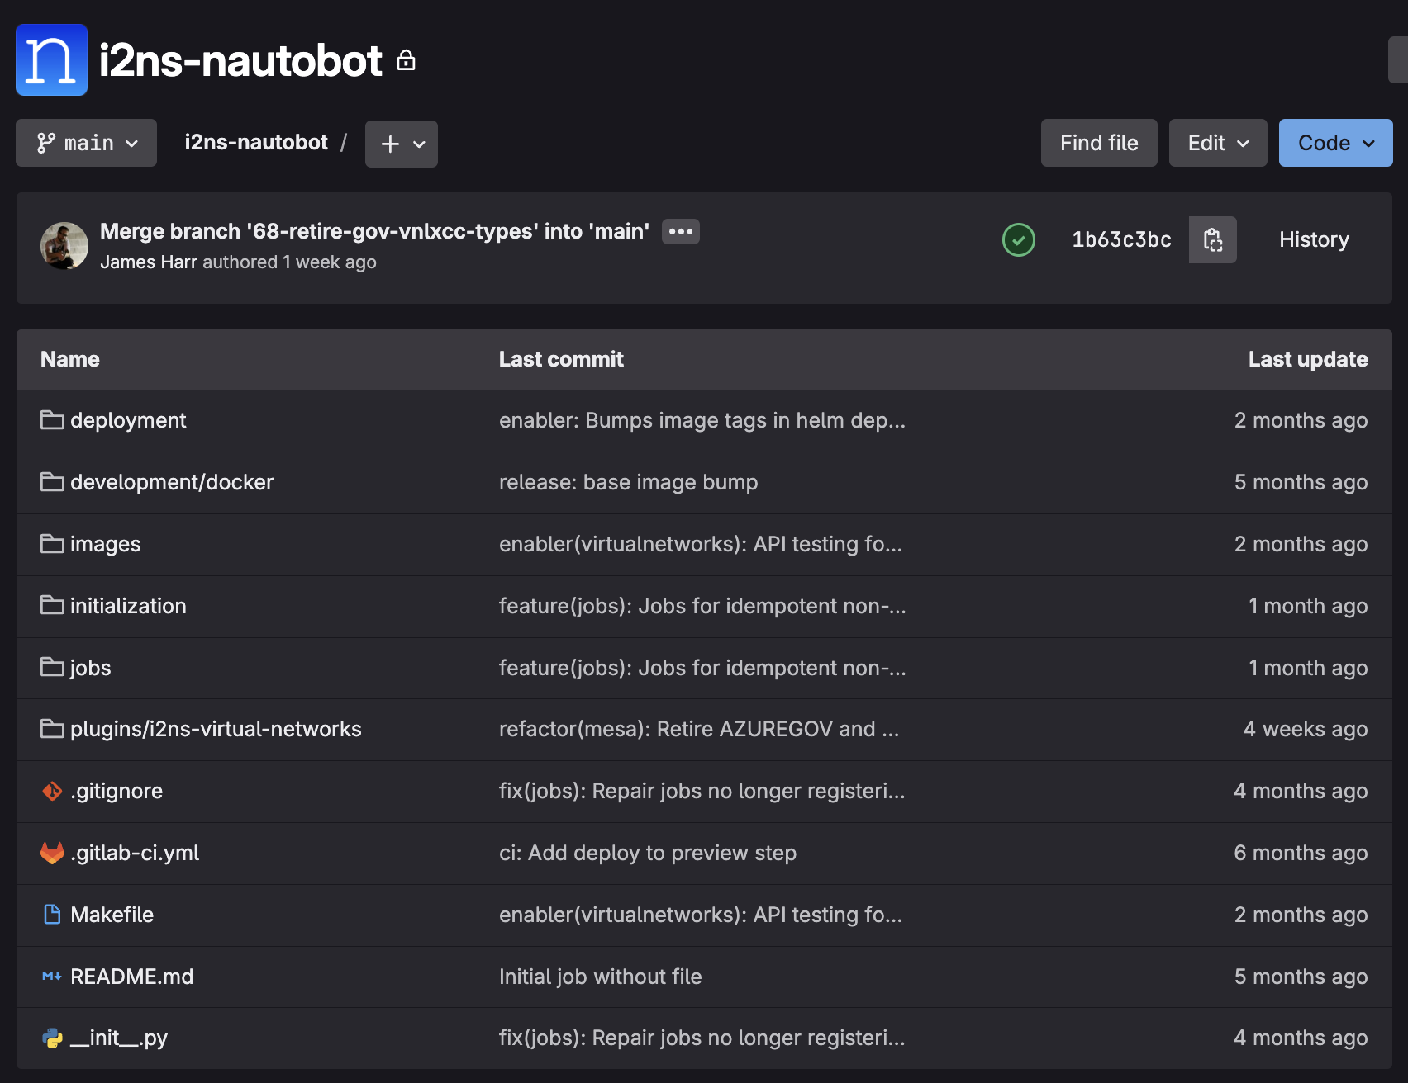
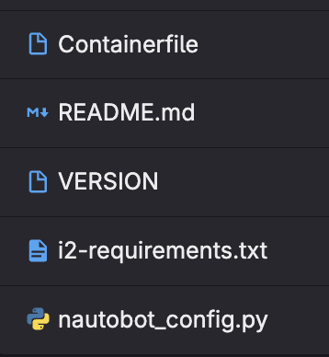
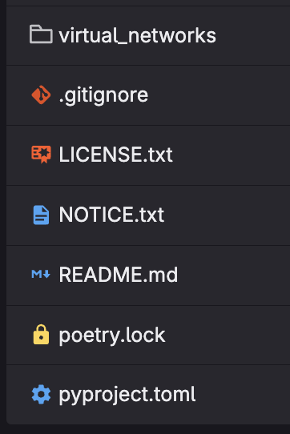
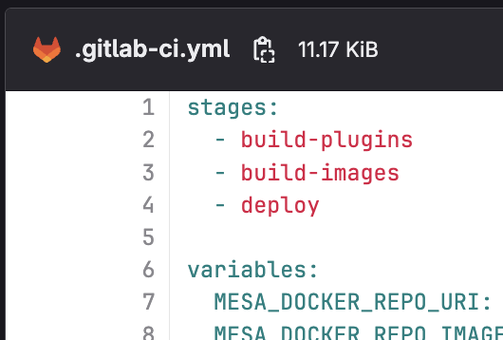

Slide 7
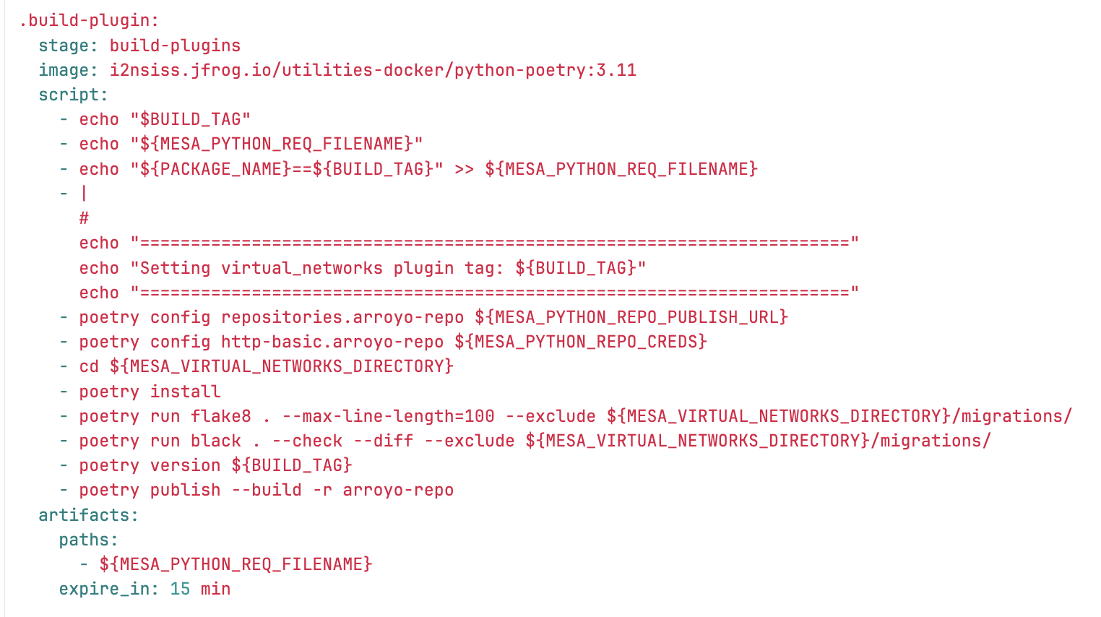

Slide 8
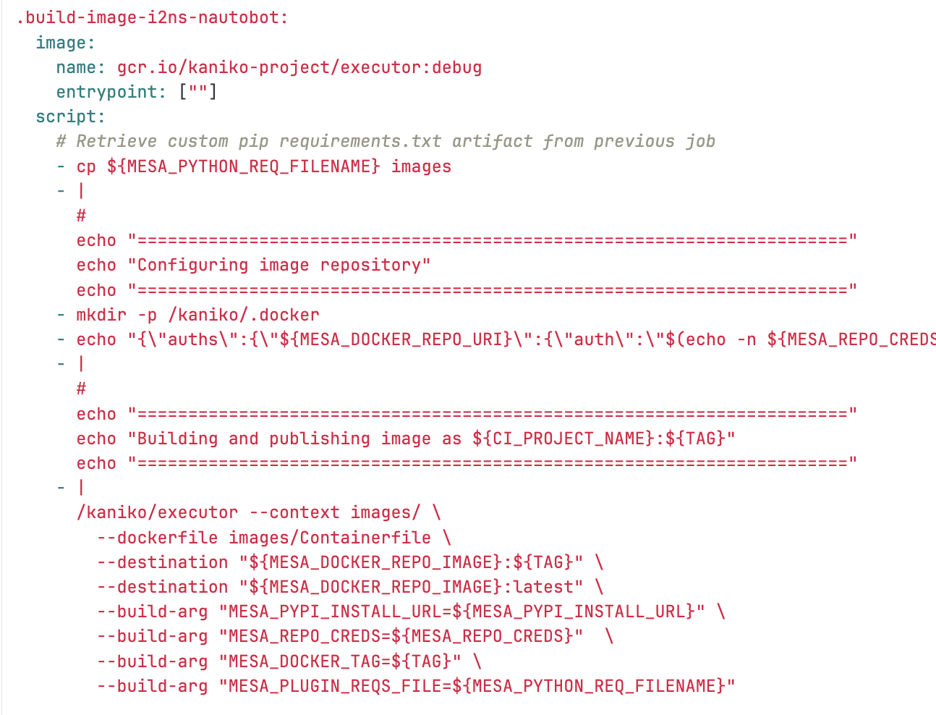
dind be like

Slide 9
